Slide 1
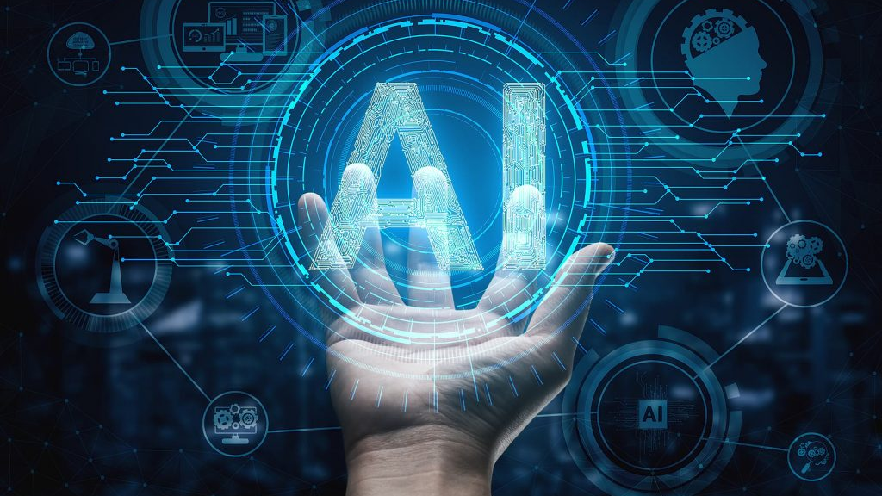

Personal AI Assist
Government Polytechnic Pune​
Group No: 17
Shubhankar karajkhede.
Prathamesh Shimpi.
Tanmay Ladhe.
Pranav Madne.
Department of Electronics & Telecommunication

Slide 2

Project Motivation
Project Introduction
Aims & Objectives
Literature Survey
H/W , S/W Requirements
Circuit Diagram
Block Diagram
Component Specifications
Advantages and Limitations
Conclusion
References

Slide 3

Project Motivation

Slide 4
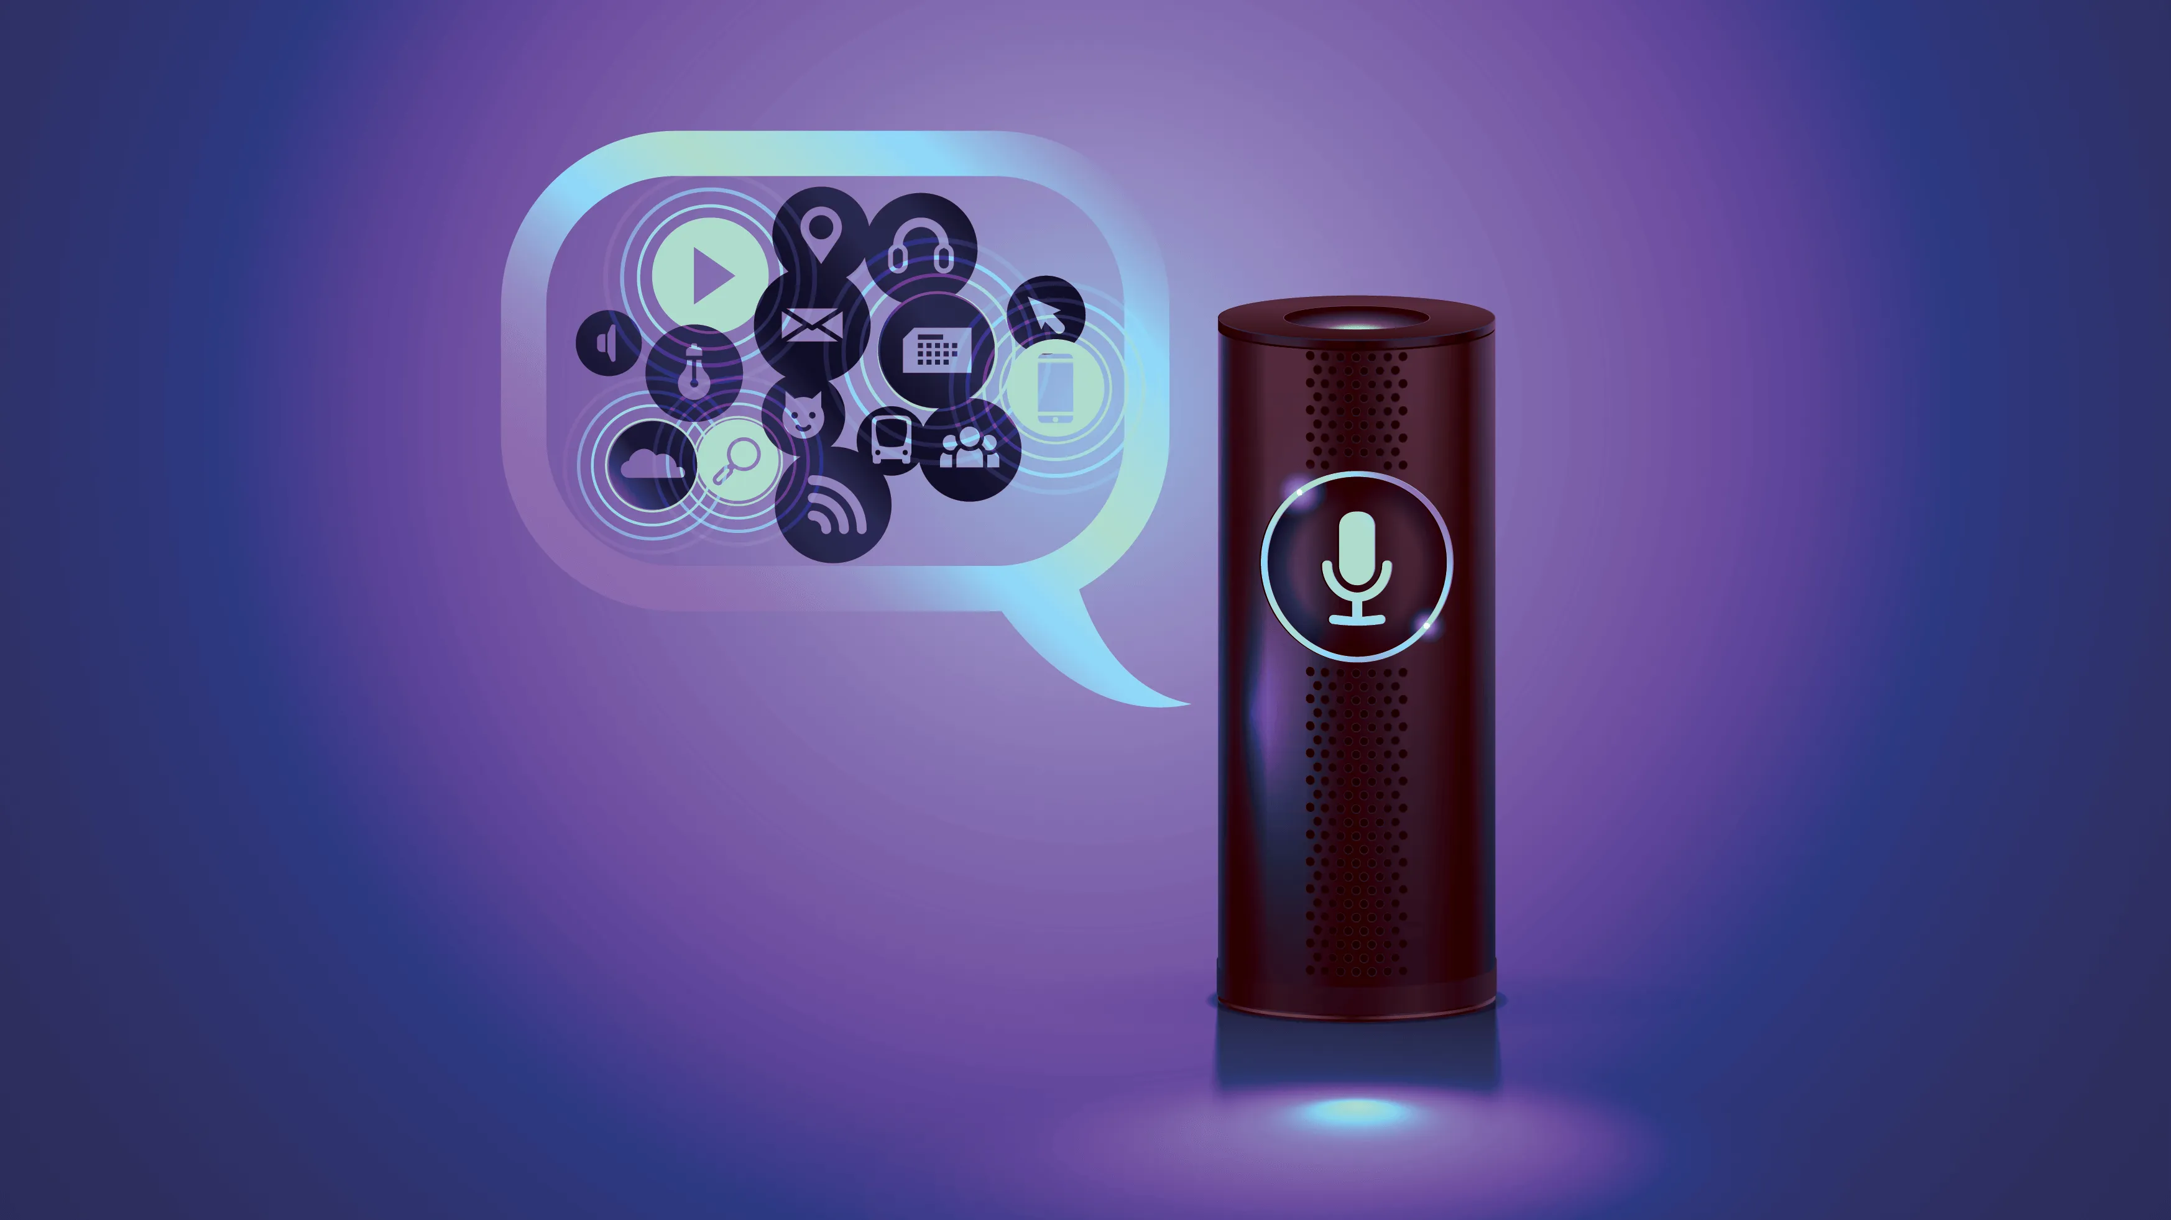
Introduction :
AI assist is program like Google or Amazon that is capable of listening, Searching and follow the command.
AI assistant or digital assistant, is an application program that understands natural language voice commands and completes tasks for the user.
A simple AI assist is one of the most common software used in any mobile or PC. We are introducing the basic concepts of AI assist.

Slide 5
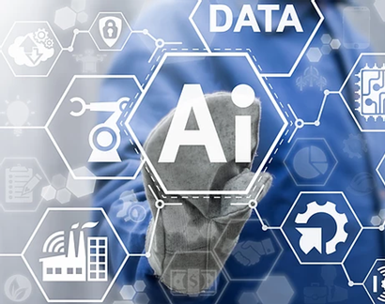
Aims & Objectives
The basic objective of AI (also called heuristic programming, machine intelligence, or the simulation of cognitive behavior) is to enable computers to perform such intellectual tasks as decision making, problem solving, perception, understanding human communication (in any language, and translate among them), and the like.
Proof of this objective is the blind test suggested by Alan Turing in the 1930s: if an observer who cannot see the actors (computer and human) cannot tell the difference between them, the objective is satisfied.

Slide 6
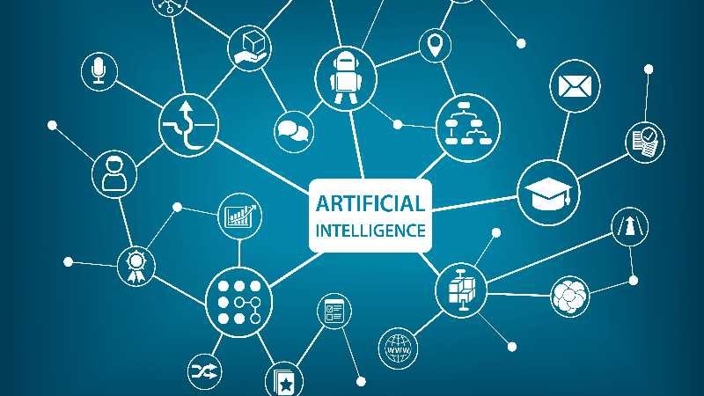
Need of AI
1. The companies today think that they want to mechanize all the regular and routine work.
2. We need Artificial Intelligence (AI) because the work that we need to do is increasing day-to-day.
3. So it's a good idea to automate the routine work. This saves the manpower of the organization and also increases the productivity.
4. So, the basic requirement of Al can start from a very small platforms to the large industries

Slide 7
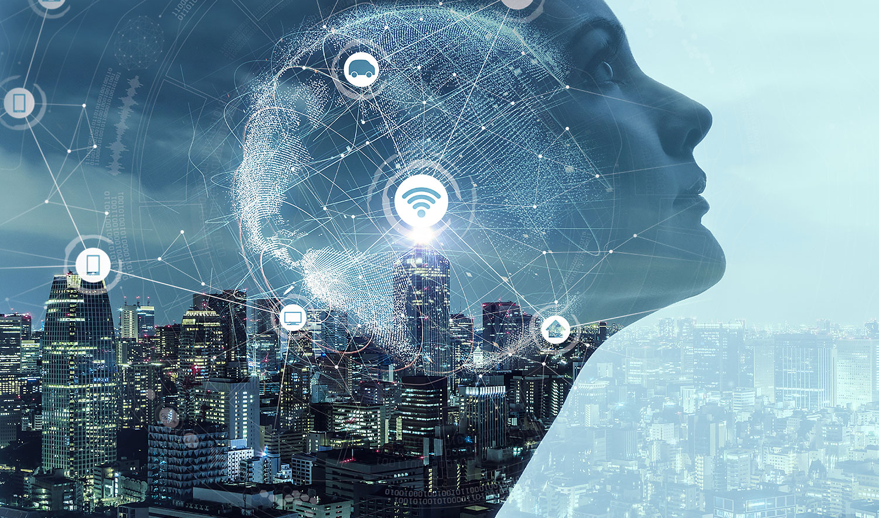
Overview
So the basic idea of this AI assistant project using the python language is to automate the day to day life task and to get the brief introduction about machine learning and artificial intelligence. In the early stages of programming and coding this particular concept of AI must be an awful thought and only few would have thought about this but in today's modern life where the technology is going beyond our imagination we can say that this project may be able to automate at least my small bedroom

Slide 8
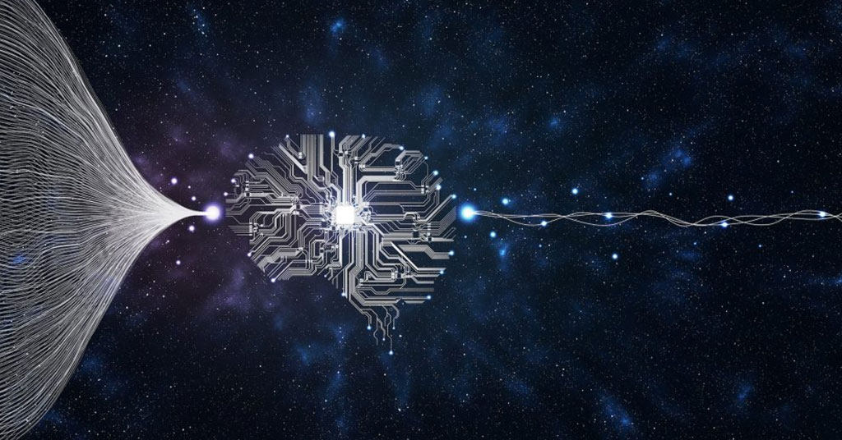
Literature

Slide 9
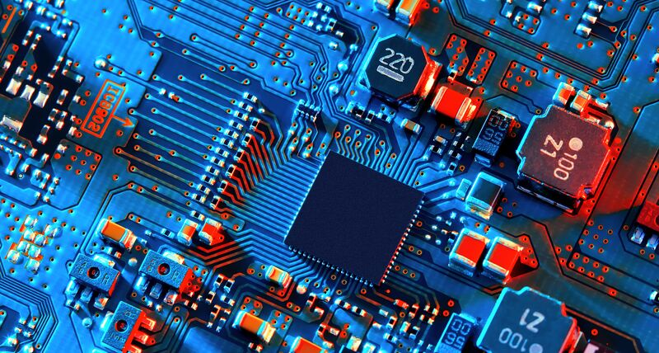
H/W , S/W Requirements
Arduino uno
12v relay board
Bulb socket
PC
Visual Studio Code (Software)
Connecting wires / jumpers
LED
Microphone
Python (Programing Language)

Slide 10
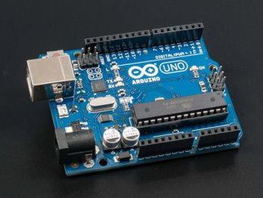
Arduino uno
Arduino is an open source electronic platform based on easy to use hardware and software. Arduino boards are able to read input such as light on sensor, finger on button and turn it into an output like activating a motor, turning on an LED etc.
Arduino is the single board microcontroller and the software used for Arduino is Arduino IDE.

Slide 11
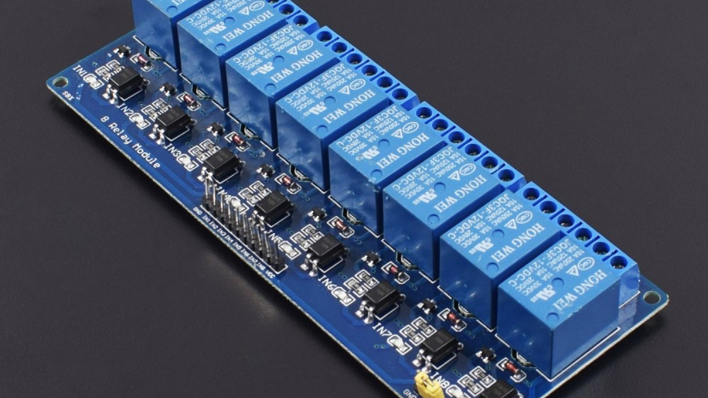
Relay board
Relay boards are computer boards with an array of relays and switches. They have input and output terminals and are designed to control the voltage supply. Relay boards provide independently programmable, real-time control for each of several onboard relay channels.
Relay boards with opto-isolators provide isolation between control signals and output controls. Most relay boards have 2, 4, 8 or 10 channels.

Slide 12

Role of Python
Python offers many features that are helpful for AI (Artificial Intelligence ) and ML (Machine Learning) in particular, and that makes it the best language for these purposes.
No wonder that various industries use Python for prediction automatic and other machine learning task

Slide 13
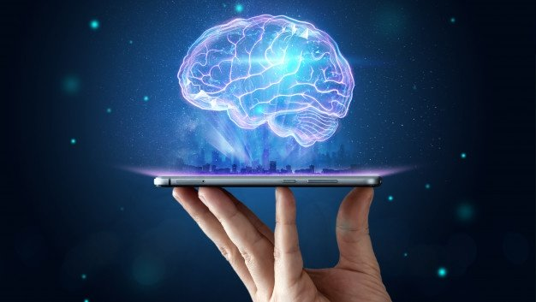
Advantage
AI is making it easier for people to do things every day, whether it's searching for photos of loved ones, breaking down language barriers in Google Translate, typing emails and more.
AI is powering many inventions in almost every domain which will help humans solve the majority of complex problems.
Using artificial intelligence we can productively automate these mundane tasks and can even remove “boring” tasks for humans
using AI we can make machines work 24x7 without any breaks

Slide 14
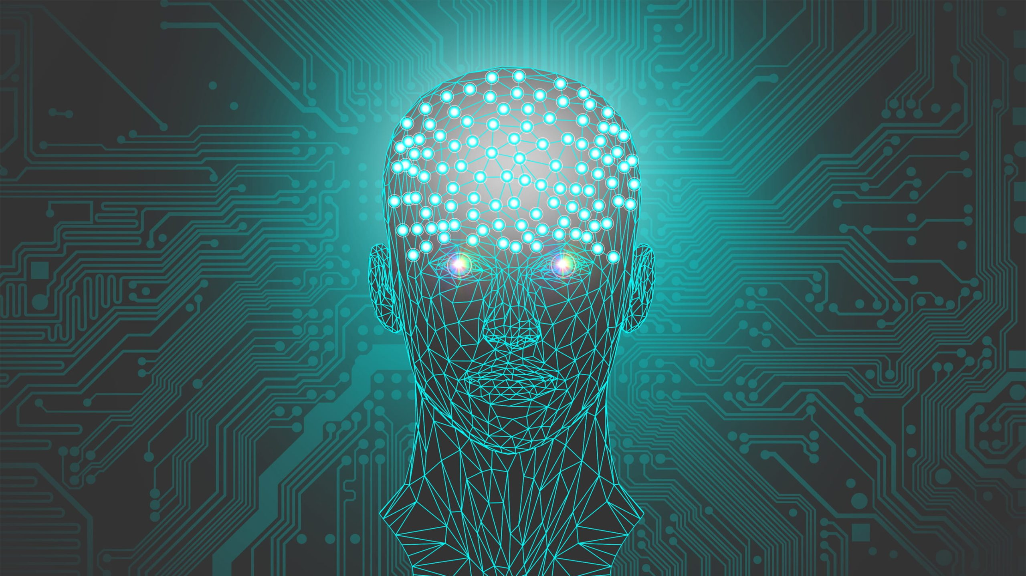
Disadvantage
It’ s creation requires huge costs as they are very complex machines.
AI is making humans lazy with its applications automating the majority of the work.
As AI is replacing the majority of works with robots, human interference is becoming less which will cause a major problem in the employment standards.

Slide 15

Al is at the center of a new enterprise to build computational models of intelligence. This small prototype with some advance modifications and proper guidelines can be turned out to very successful product because in the field of artificial intelligence 'sky is the only limit'

Slide 16
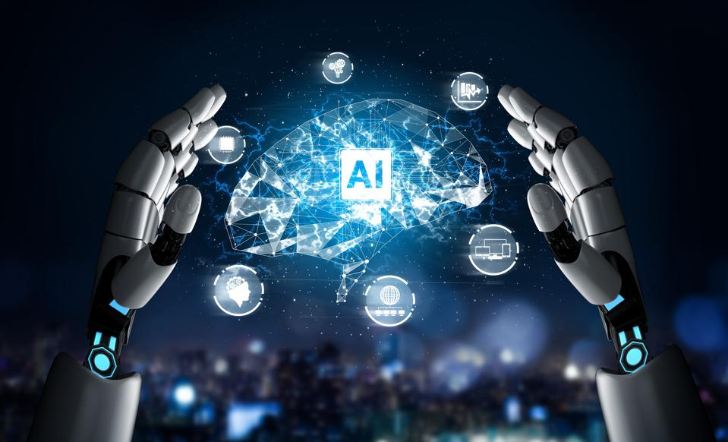
REFERENCES
https://towardsdatascience.com/
https://www.globalspec.com/
https://www.linkedin.com/
https://emerituscollege.asu.edu/

